Slide 1
Satellite Image Classification with Deep Learning
Indrasena Kallam
Springboard Data Science Bootcamp

Slide 2
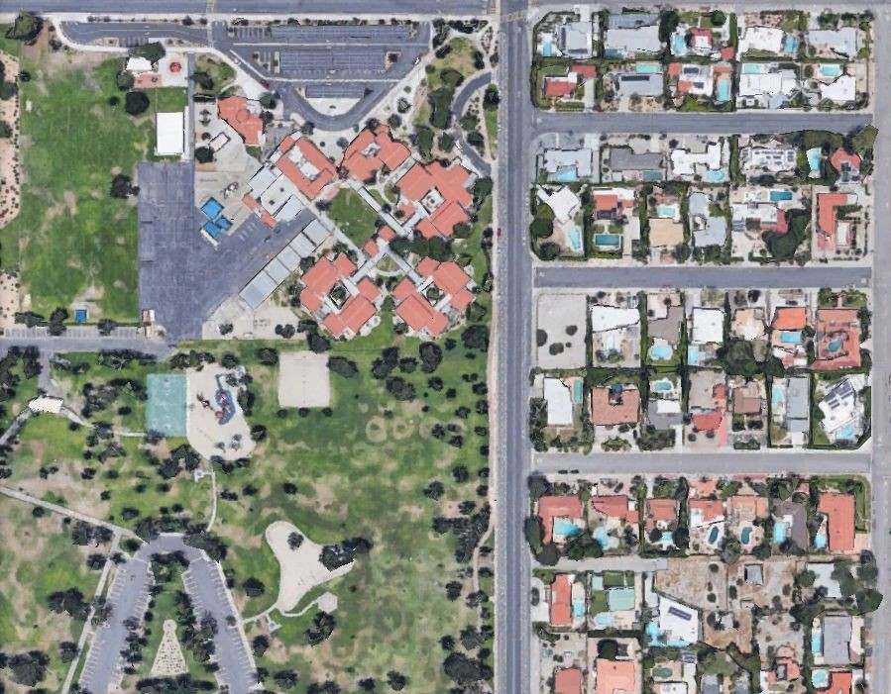
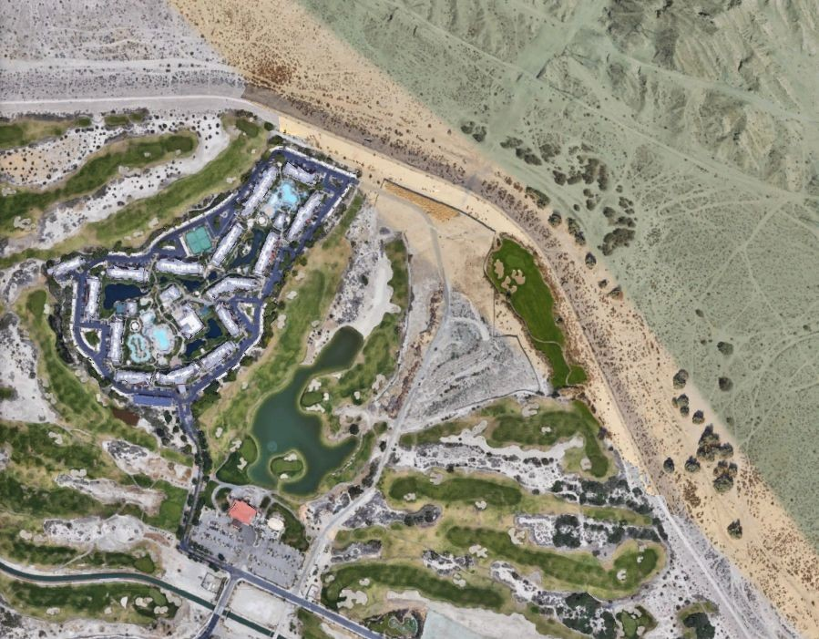
Overview
Satellite images
Rapid growth in data acquisition
Applications
Agriculture
Insurance
Disaster Response
Land Use Management
Environmental Management
Common use-case: classify land uses within area of interest
Classification of land ,water, building, Barren lands etc.
Screen captures from Google Earth

Slide 3
Why Deep Learning?
Challenges:
Big data
Significant intra-class variability Why Deep Learning?
Traditional supervised learning methods like random forest do not scale well to big data.
CNNs can use the underlying structure in images for classification. Context.

Slide 4
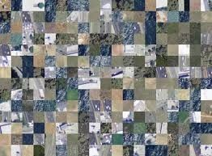
DeepSat-6 Dataset
Labelled satellite imagery dataset, used for benchmarking classification models
405,000 patches sampled from NAIP No spatial context
28x28 pixel tiles
1 meter resolution
4 bands: R,G,B,IR
6 class labels: building, barren land, tree, grassland, road, water Training: 324,000 tiles (80%), Test: 81,000 tiles (20%)

Slide 5
Computer Vision Approach
Basic Architecture
Convolutional Base
Dense Classifier
Approaches
Build and train CNN from scratch
Transfer Learning
Repurpose pre-trained CNN base (VGG16, Resnet) + custom classifier
Training options:
Apply convolutional base to dataset, fit classifier to numpy array output
Attach classifier to frozen convolutional base, train classifier model
Like prior, also re-train top layers of base (fine-tuning)
Unfreeze base and retrain entire

Slide 6
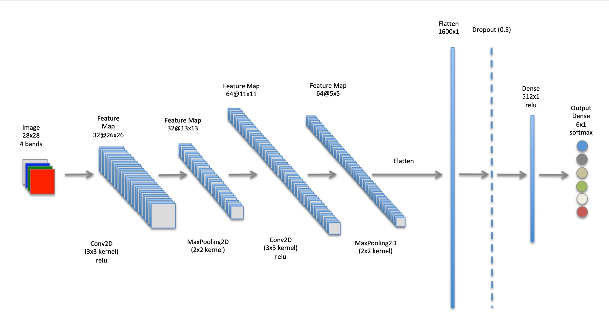
Baseline CNN - Architecture
Input
ImageDataGenerator (train,val)
Convolutional Base
Maxpooling - downsampling
Relu - nonlinearity
Learns patterns at different scales
Translation invariant
Dense Classifier
Learn global pattern
Softmax
Dropout
Output classification

Slide 7

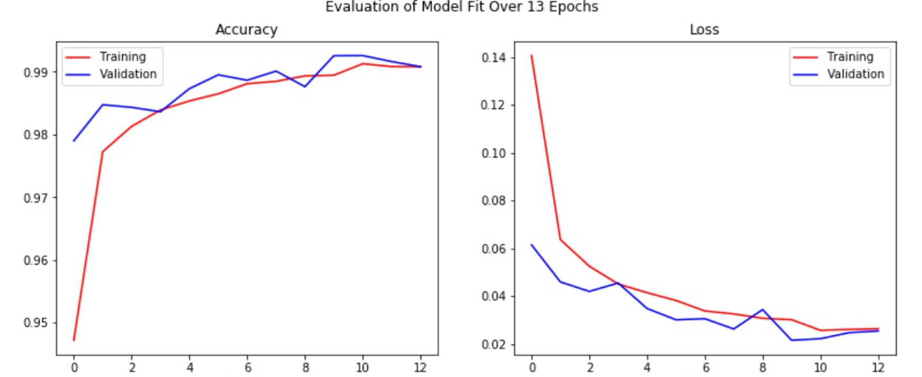



Baseline Model - Training Performance

Slide 8

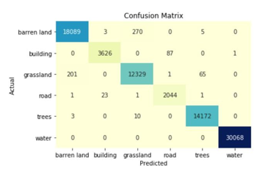
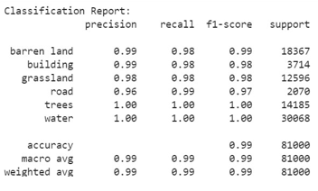
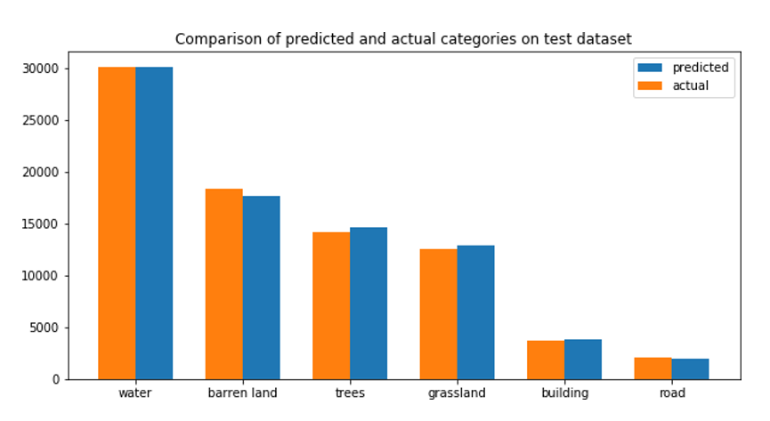
Baseline Model - Test Performance

Slide 9
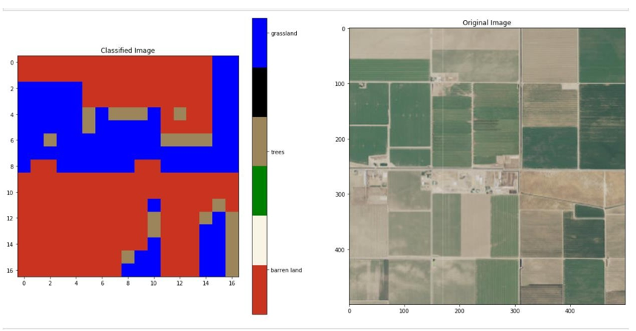
Apply Baseline Model to New Image

Slide 10
Summary of Results
Applied Deep Learning with CNN to classify satellite image tiles
Used DeepSat6 benchmarking dataset
Applied Baseline CNN to new NAIP imagery
Accuracy :Simple Baseline CNN (99.2% accuracy)

